Slide 1
TITLE AI-BASED LOCALIZATION AND CLASSIFICATION OF SKIN DISEASE WITH ERYTHEMA
DONE BY:
GOKULNATH S (19C025)
RAJA Rajeshwari a s (19C076)
THIRUMOORTHY R (19C107)
VIKASH J (19C139)

Slide 2
ABSTRACT:
This project describes the skin disease detection and classification using CNN algorithm.
We have used Deep Learning to train our model, Deep Learning is a part of Machine Learning in which unlike Machine Learning it uses large dataset and hence the number of classifiers is reduced substantially.
The machine learns itself and divide the data provided into the levels of prediction and in a very short period of time gives the accurate results, thereby promoting and supporting development of Dermatology.
The algorithm that we have used is Convolutional Neural Network (CNN) as it is one of the most preferred algorithm for image classification.

Slide 3
INTRODUCTION:
Skin diseases remain a major cause of disability worldwide, and skin conditions pose a significant threat to patient well-being.
Skin conditions accounted for 1.79% of the global burden, measured in disability-adjusted life years (DALYs), of 306 diseases and injuries in 2013.
Malignant melanoma is a highly aggressive cancer that tends to spread to other parts of the body, and may be fatal if not treated early.
Melanoma is detected at an early stage, it can usually be completely removed with surgery. Recently, deep learning has played a vital role in the early detection of cancer.

Slide 4
PROBLRM STATEMENT
Now a day’s people are suffering from skin diseases, More than 125 million people suffering from Psoriasis
skin cancer rate is rapidly increasing over the last few decades especially Melanoma is most diversifying skin cancer.
If skin diseases are not treated at an earlier stage, then it may lead to complications in the body including spreading of the infection from one individual to the other.
The skin diseases can be prevented by investigating the infected region at an early stage.
The characteristic of the skin images is diversified so that it is a challenging job to devise an efficient and robust algorithm for automatic detection of skin disease and its severity.

Slide 5
OBJECTIVES
To build a model which could be used for the prevention and early detection of skin cancer, psoriasis.
To analyze the images of skin and detect whether the person is having skin disease or not.

Slide 6
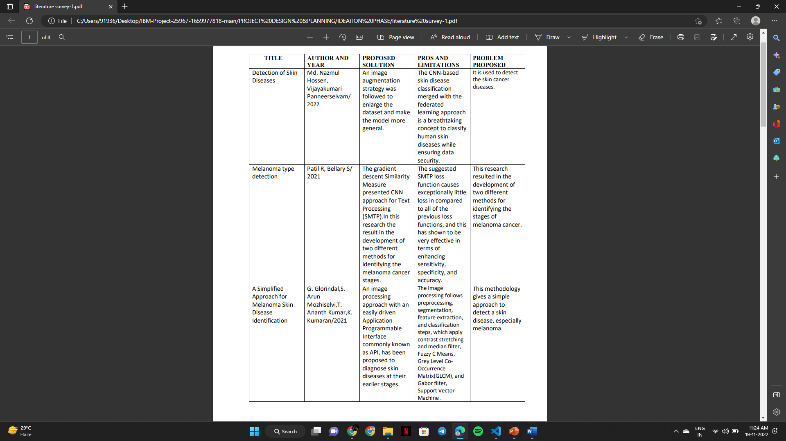
EXISTING SYSTEM

Slide 7
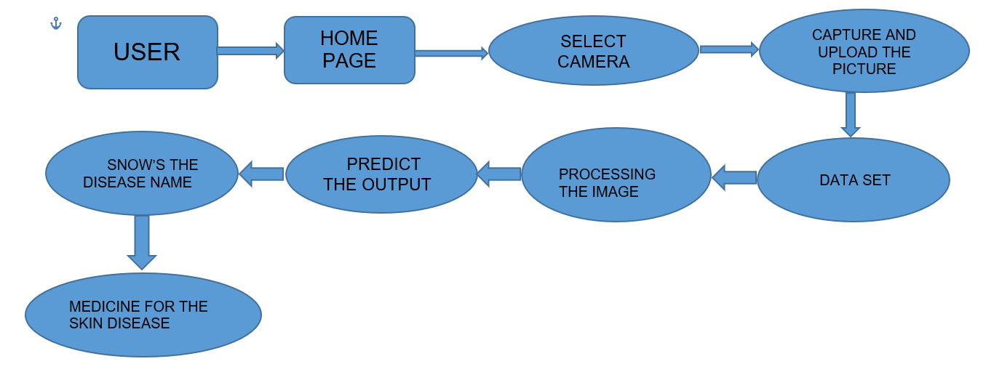
PROPOSED SOLUTION:

Slide 8
LIBRARIES USED:
Numpy
Keras
Tensorflow
Pandas
Matplotlib
Numpy
Flask
Seaborn

Slide 9
It has 7 different classes of skin cancer which are listed below :
1. Melanocytic nevi
2. Melanoma
3. Benign keratosis-like lesions
4. Basal cell carcinoma
5. Actinic keratoses
6. Vascular lesions

Slide 10
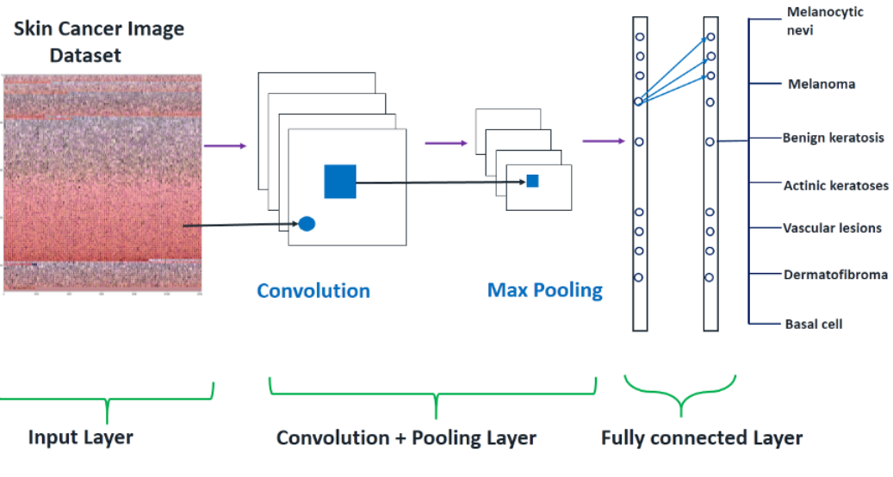
CNN MODEL
The dataset consists of 10015 dermatoscopic images which can serve as a training set for academic machine learning purposes.
The objective to build deep learning model to classify given query image into one of the 7 different classes of skin cancer.

Slide 11
Steps for model building and evaluation which are as follows :
Step 1: Importing Essential Libraries
Step 2: Loading data and Making labels
Step 3: Train Test Split
Step 4: Exploratory data analysis (EDA)
Step 5: Model Building (CNN)
Step 6: Setting Optimizer & Annealing
Step 7: Fitting the model
Step 8: Model Evaluation

Slide 12
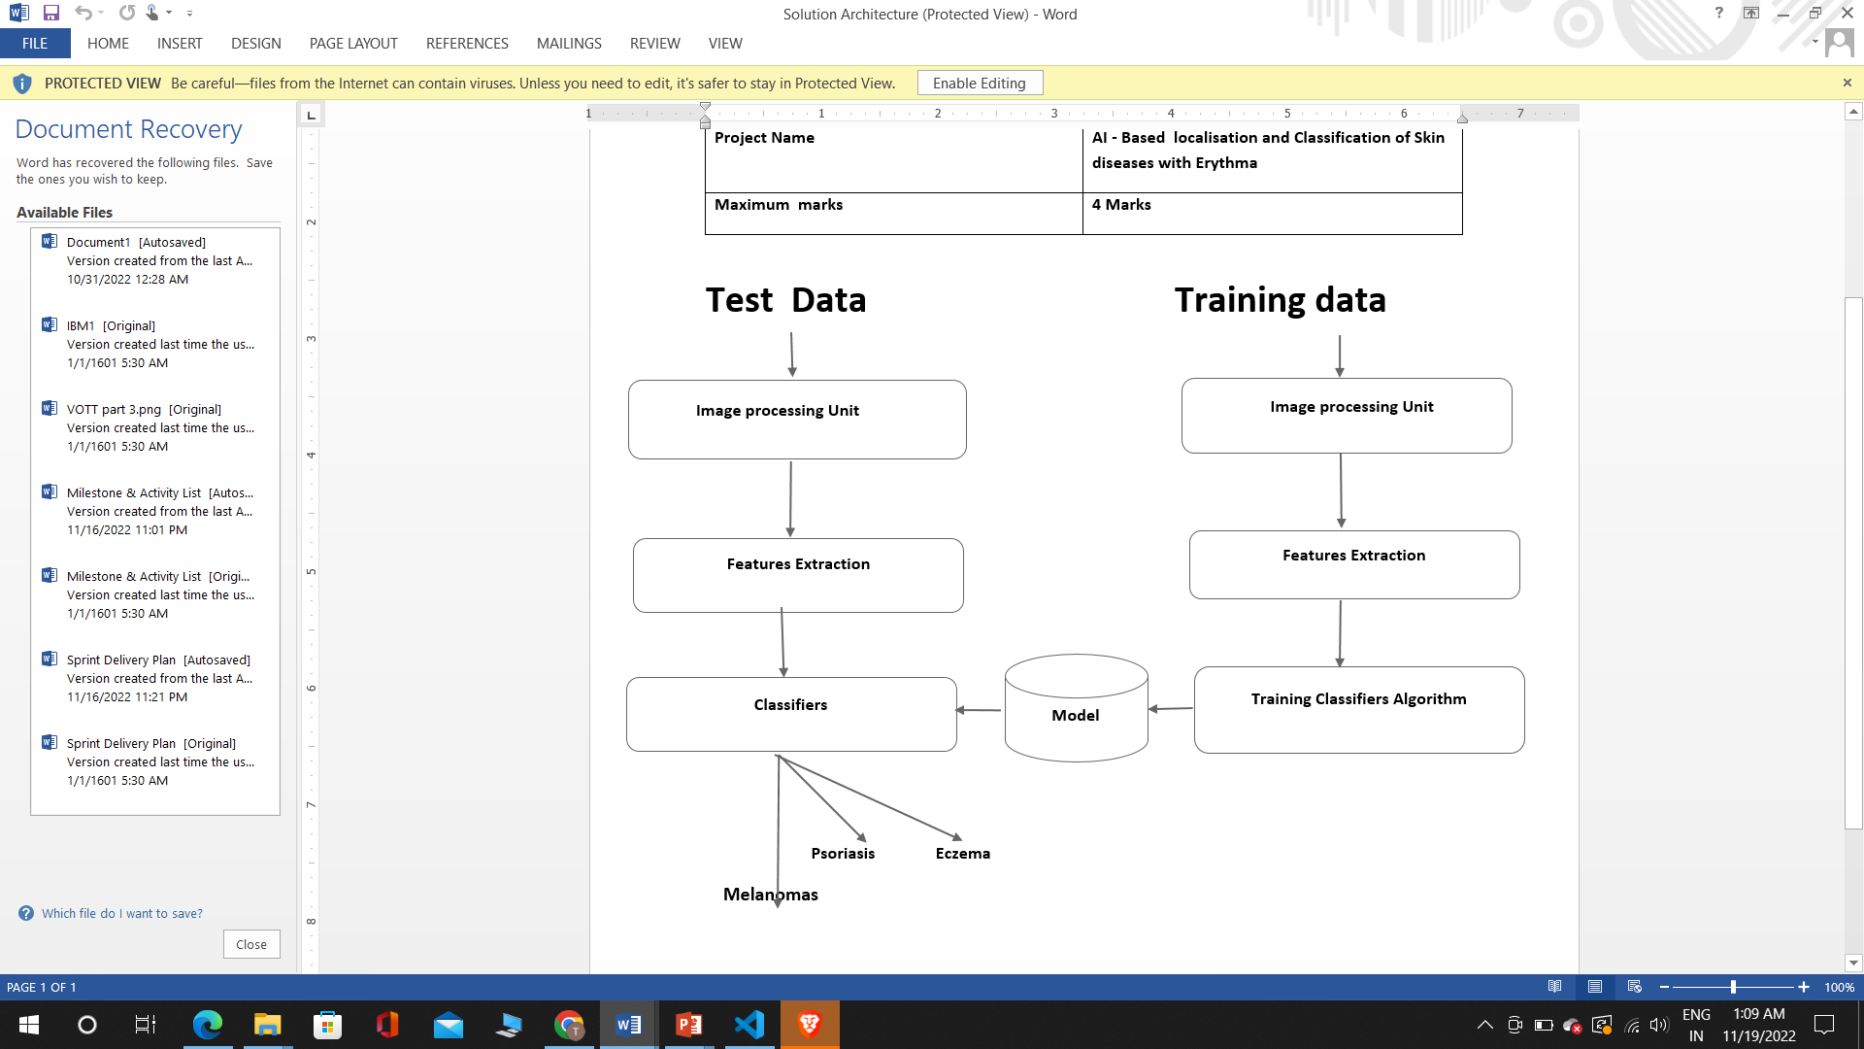
BLOCK DIAGRAM:

Slide 13
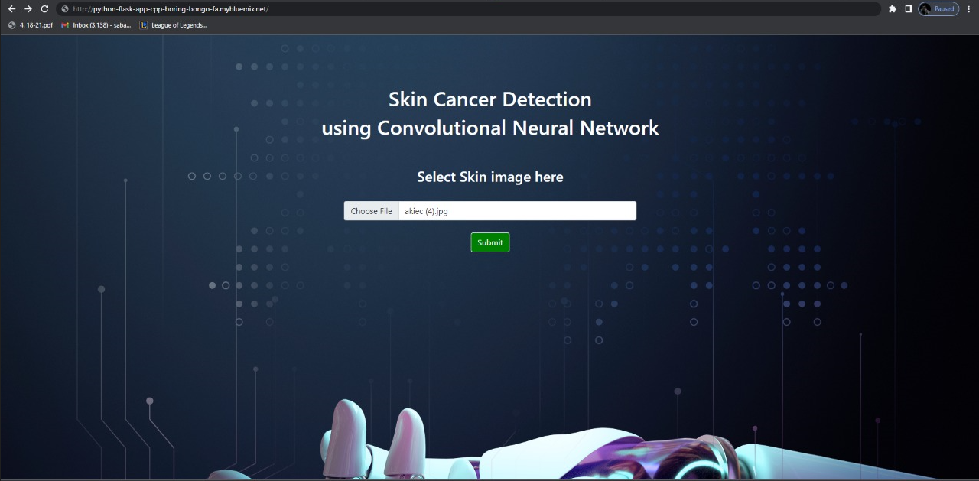
OUTPUT SCREENSHOTS:

Slide 14
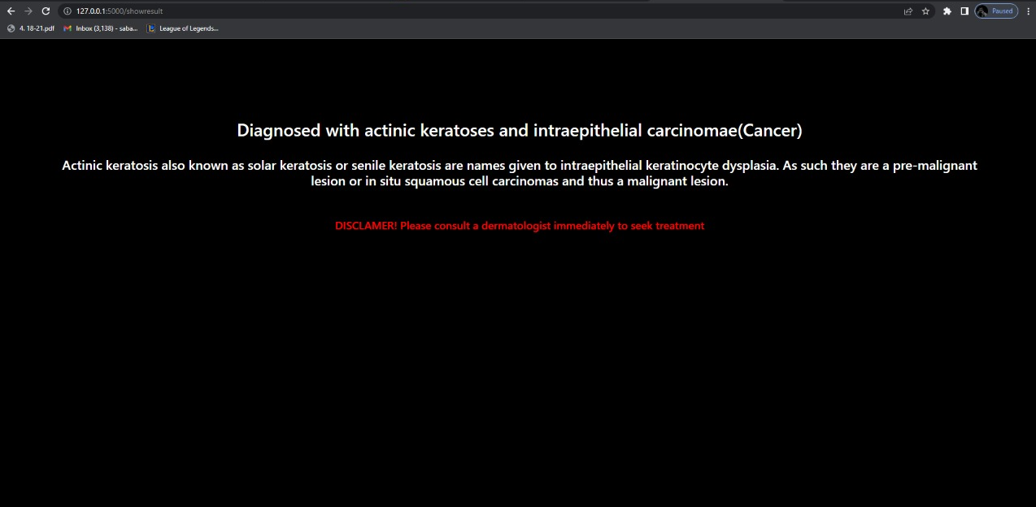

Slide 15
CONCLUSION
Skin Diseases are ranked fourth most common cause of human illness, but many still do not consult doctors. We presented a robust and automated method for the diagnosis of dermatological diseases. Treatments for skin are more effective and less disfiguring when found early. We should point out that it is to replace doctors because no machine can yet replace the human input on analysis and intuition. Researches in European Society of Medical Oncology have shown for the first time that form of AI or ML is better than experienced dermatologists. In this a brief description of the system and the implementation methodology is presented.

Slide 16
THANK YOU

